Slide 2
https://adst.org/OH%20TOCs/ADST.HistoryofUSDiplomacy.Book.small.pdf
https://adst.org/OH%20TOCs/ADST.HistoryofUSDiplomacy.Panels.8.5x11.pdf

Slide 3
This PowerPoint in hyperlinked and intended for
reference if Prezi is unavailable
The Prezi may be found here: https://prezi.com/view/EWuLOxqtWoX35HBuTfwz/

Slide 5
https://adst.org/OH%20TOCs/ADST.HistoryofUSDiplomacy.Book.small.pdf
https://adst.org/OH%20TOCs/ADST.HistoryofUSDiplomacy.Panels.8.5x11.pdf

Slide 6
https://www.doe.virginia.gov/testing/sol/standards_docs/history_socialscience/index.shtml

Slide 9
https://www.loc.gov/rr/main/images/chinese-exclusion-act.pdf

Slide 10
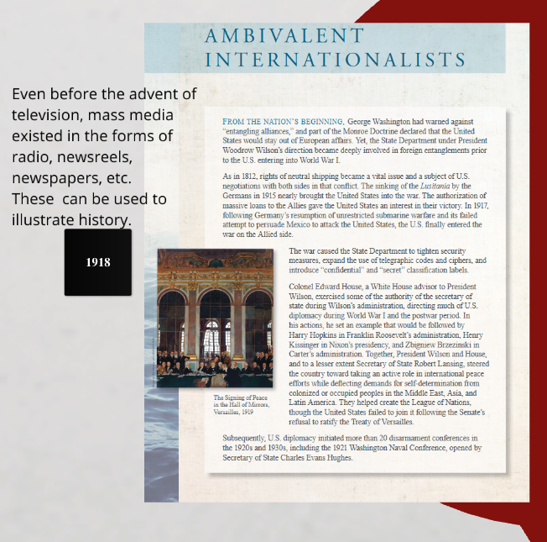

Slide 11
https://www.loc.gov/item/mp76000040/

Slide 12
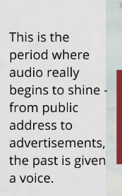

Slide 13
https://adst.org/wp-content/uploads/2012/09/Lyon-Cecil-on-Cornelia-Bassell.pdf

Slide 14
https://www.loc.gov/item/afccal000100/

Slide 16
https://www.adst.org/OH%20TOCs/Veliotes,%20Nicholas%20A.toc.pdf
https://www.adst.org/OH%20TOCs/Laingen,%20Penelope.toc.pdf
https://www.adst.org/OH%20TOCs/Wilcox,%20Phillip%20C.toc.pdf
https://adst.org/wp-content/uploads/2013/12/Mbenna-Vella-Gene.pdf

Slide 18
https://www.adst.org/OH%20TOCs/Peck.Edward.pdf
https://adst.org/OH%20TOCs/Cella.Glenn.pdf
https://www.adst.org/OH%20TOCs/Oakley.Robert.B.pdf

Slide 19
https://www.loc.gov/item/94838614/

Slide 20
https://www.loc.gov/item/webcast-7410/
https://www.loc.gov/item/webcast-9812/

Slide 22
https://www.loc.gov/item/2019641686/

Slide 23
https://www.adst.org/OH%20TOCs/Oakley%2C%20Robert%20B.toc.pdf

Slide 24
https://www.loc.gov/item/mfdipbib000187/

Slide 25
https://adst.org/oral-history/oral-history-interviews/
https://www.loc.gov/collections/

Slide 26
HOW TO USE: ADST Oral Histories

Slide 27
HOW TO USE: LoC Digital Archives

